Slide 1

Warehouse management
Sebastian Stachowiak, MSc Eng.

Slide 2
Agenda
Introduction
Warehouse Management Systems
Warehouse processes digitizing
Abstraction in IT

Slide 3
Agenda
Introduction
Warehouse Management Systems
Warehouse processes digitizing
Abstraction in IT

Slide 4
Introduction
Practice
Science
Applied Doctorate
Notes:
Technical aspects:
please tell me that everything is OK if you go out
do not hesitate ask question if you have any

Slide 5
Introduction
A few words about you?

Slide 6
Agenda
Introduction
Warehouse Management Systems
Warehouse processes digitizing
Abstraction in IT

Slide 7
Agenda
Introduction
Warehouse Management Systems
Warehouse processes digitizing
Abstraction in IT

Slide 8

Warehouse Management
Warehouse characteristics
Warehouse functions
WMS
Faber, de Koster, Smidts, 2013, p.1231
Notes:
Researchers ponit a few dimentions of warehouse management.
Characteristics of a warechouse.
It’s functions, e.g. storing resources for the future production (cars), storing durig a delivery proces (parcels), storing goods after production and before release (cars also).
WMS

Slide 9
Warehouse Management
Warehouse characteristics
Warehouse functions
WMS
Faber, de Koster, Smidts, 2013, p.1231
Notes:
Researchers ponit a few dimentions of warehouse management.
Characteristics of a warechouse.
It’s functions, e.g. storing resources for the future production (cars), storing durig a delivery proces (parcels), storing goods after production and before release (cars also).
WMS

Slide 10
Warehouse management Systems
Environment
Factor | Value | Reason
Size of a company | Medium-sized and large enterprises | Cost of an implementation is quite large
Amount and sizes of Logistics procesess | Scale of the served Logistics processes is big enough | Profit from implementation has to cover costs
Companies’ needs | Improvement area of warehouse management | Research*
Own work based on Jurczak, M. (2019), p. 26-32

Slide 11
Advantages
Own work based on https://www.erp-view.pl/wms/20376-polski-rynek-wms-pod-lup-consafe-logistics.html, 2019

Slide 12
WMS functions
Analysis and investigation
Optimization and improvement
Wang, 2013, p.111
Notes:
Analiza i badanie

Slide 13
WMS functions
Analysis and investigation
Optimization and improvement
Enterprise knowledge increasing (know how)
Work quality improve
Planning improve
Structure enhancement
Effective storage management
Wang, 2013, p.111

Slide 14
WMS Modules
WMS I
WMS A
Goods receipts improvement
Facilitation of localization and goods issue
Easy integration with other systems
Automation of the workflow of documents and reports
Inventory double time reducement
HR problems resolutions
Management of goods received
Management of locations in the pallet flow racks
Stock control
Dispatch of goods
https://jmblab.com/pl/system-wms/
https://www.interlakemecalux.com/warehouse-manual/the-warehouse/what-is-warehouse-management-system-wms

Slide 15
WMS in enterprise and surroundings
ERP
SRM
CRM
WMS
SCM
Notes:
Warehouse Management System
Customer Relationship Management
Supply Chain Management
Supplier Relationship Management
ERP

Slide 16
WMS in enterprise and surroundings
WMS
ERP
SCM
SRM
CRM
Notes:
Warehouse Management System
Customer Relationship Management
Supply Chain Management
Supplier Relationship Management
ERP

Slide 17
WMS in enterprise and surroundings
SRM
CRM
ERP
WMS
SCM
Notes:
Warehouse Management System
Customer Relationship Management
Supply Chain Management
Supplier Relationship Management
ERP

Slide 18
Technologies used in WMS
Communication
Identification
Completion
Wireless (e.g. WiFi, Bluetooth, GSM)
Wired
RFID
Barcode (e.g. 1D, 2D)
Pick by light
Pick by voice
AR (Augumented reality)
Internet of Things

Slide 19
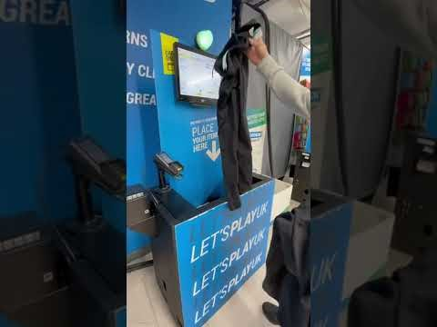
RFID

Slide 20

Augumented Reality (cartoon released 1989-1996)

Slide 21

Augumented Reality

Slide 22

Augumented Reality

Slide 23
Summary
System expectations
The most important
Decision making support
Integration (with other systems)
Lower costs
System has to be adjusted to the needs of the company
High speed and high efficiency of warehouse processes
Jurczak, M. (2019), s 26-32
Mao, J., Xing, H., & Zhang, X. (2018), p. 1355-1367
Notes:
DMS – Logistics 4.0

Slide 24
Agenda
Introduction
Warehouse Management Systems
Warehouse processes digitizing
Abstraction in IT

Slide 25
Agenda
Introduction
Warehouse Management Systems
Warehouse processes digitizing
Abstraction in IT

Slide 26
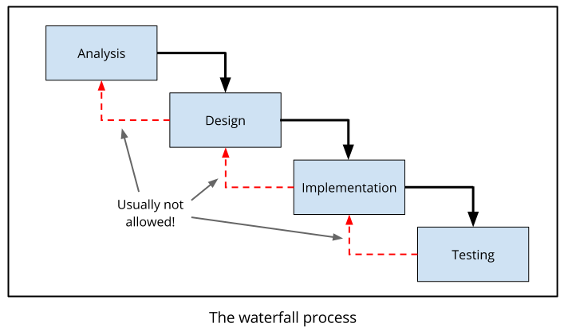
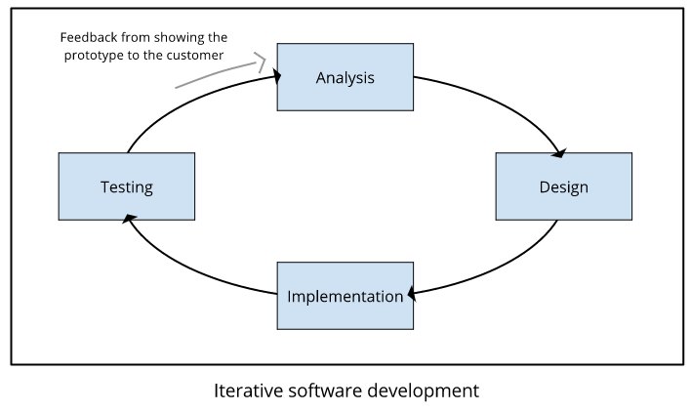
Software engineering
Waterfall
Agile software development
To zdjęcie, autor: Nieznany autor, licencja: CC BY-SA-NC
To zdjęcie, autor: Nieznany autor, licencja: CC BY-SA-NC

Slide 27


Analysis
Analysis
Design
What do you need?
How does it work?
How it looks like?

Slide 28
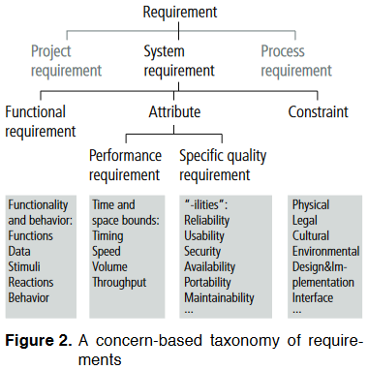
Requirements
Functional
Non-functional
Glinz, M. (2007, October), p. 25
“a function that a system (...) must be able
to perform”,
“what the product must do”,
“what the system should do”
Glinz, M. (2007, October), p. 21

Slide 29
Documents
Use Cases
System Boundary
User scenario
BPMN diagrams
Process flow
Test Cases
Steps to execute in defined environment with particular results
UML
17 types of diagrams, system models
User Stories
Informal description of user possibilities

Slide 30
Agenda
Introduction
Warehouse Management Systems
Warehouse processes digitizing
Abstraction in IT

Slide 31
Agenda
Introduction
Warehouse Management Systems
Warehouse processes digitizing
Abstraction in IT

Slide 32








Abstraction

Slide 33
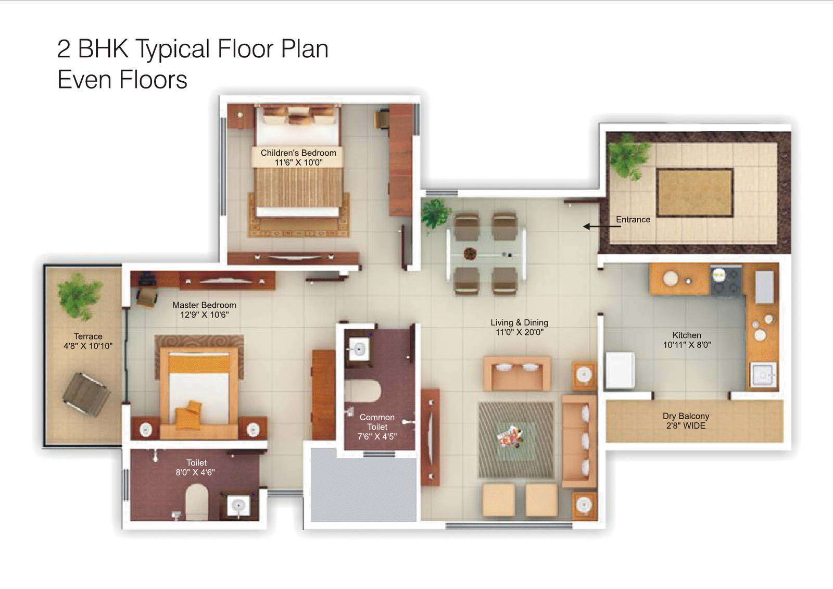
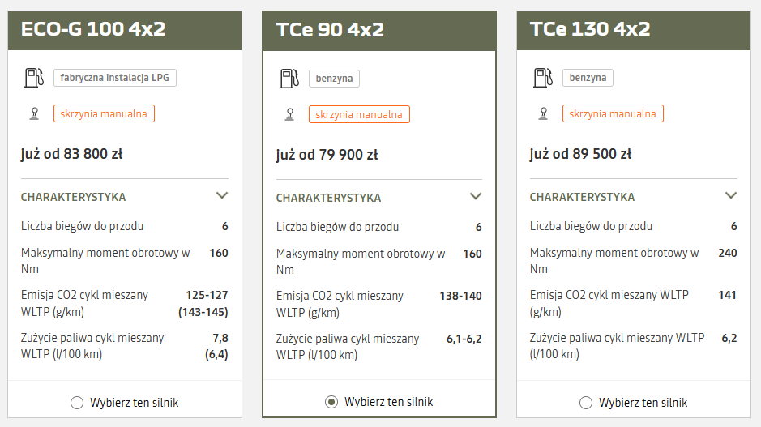
Abstraction - examples
To zdjęcie, autor: Nieznany autor, licencja: CC BY-NC-ND
https://www.dacia.pl/samochody/nowy-duster/konfigurator/silniki.html?conf=https%3A%2F%2Fpl.co.rplug.renault.com%2Fc%2FBADWq%2FAlFgfA

Slide 34
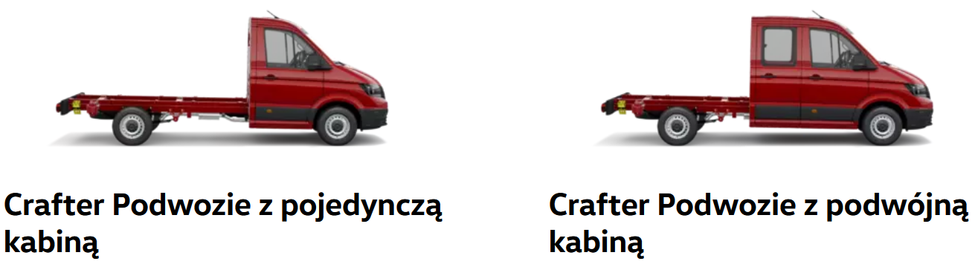
Abstraction - examples
Single cabin
Double cabin
https://www.vwdostawcze.pl/pl/modele/crafter-podwozie.html

Slide 35
WMS in enterprise and surroundings
SRM
CRM
ERP
NewWMS
WMS
SCM

Slide 36
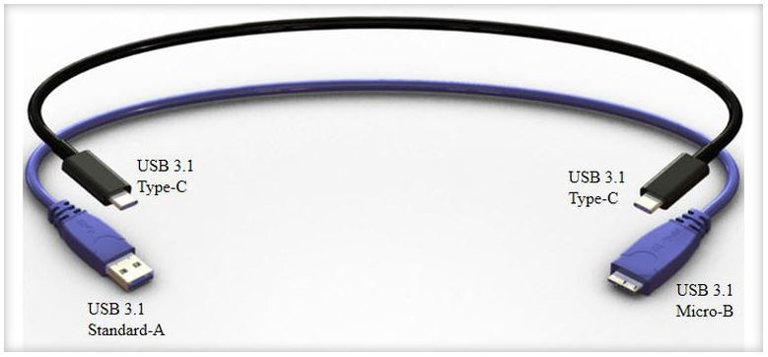
Abstraction
Standards allow us to use abstraction
Window in a house project, engine in a car or even same chassis in a different car models.
WMS interface – it does not metter which solution will be applied
To zdjęcie, autor: Nieznany autor, licencja: CC BY-NC-ND

Slide 37
Agenda
Introduction
Warehouse Management Systems
Warehouse processes digitizing
Abstraction in IT

Slide 38
Agenda
Introduction
Warehouse Management Systems
Warehouse processes digitizing
Abstraction in IT

Slide 39
Bibliography
Faber, N., De Koster, M. B. M., & Smidts, A. (2013). Organizing warehouse management. International Journal of Operations & Production Management, 33(9), 1230-1256.
Glinz, M. (2007, October). On non-functional requirements. In 15th IEEE international requirements engineering conference (RE 2007) (pp. 21-26). IEEE.
Jurczak, M. (2019). Ewolucja i kierunki rozwoju systemów klasy WMS. Gospodarka Materiałowa i Logistyka, (6), 26-32.
Mao, J., Xing, H., & Zhang, X. (2018). Design of intelligent warehouse management system. Wireless Personal Communications, 102, 1355-1367.
Wang, H. (2013). Logistics Enterprise Warehouse Management System Optimization. In Informatics and Management Science V (pp. 107-113). Springer London.
Internet sources:
https://bezkomputera.wmi.amu.edu.pl/ppi/teacher/chapters/software-engineering.html, 15.05.2023
https://www.csfieldguide.org.nz/en/chapters/software-engineering/analysis/, 15.05.2023
https://www.dacia.pl/, 15.05.2023
https://www.erp-view.pl/wms/20376-polski-rynek-wms-pod-lup-consafe-logistics.html, 2019
https://www.interlakemecalux.com/warehouse-manual/the-warehouse/what-is-warehouse-management-system-wms, 15.05.2023
https://jmblab.com/pl/system-wms/, 15.05.2023
https://www.vwdostawcze.pl/pl/modele/crafter-podwozie.html, 15.05.2023

Slide 40

Thank you!
Sebastian.Stachowiak@doctorate.put.poznan.pl
courtesy copy: paulina.golinska@put.poznan.pl

